Slide 1
“Enzo” the Multy-Tasking Robot
A technical yet fun guide to our robot.

Slide 2
TABLE OF CONTENTS
01
02
03
04
Introduction
Working Principles
Components
Y-Section
A brief introduction about who we are, robotics, robots and of course, our robot
What is “Enzo the robot” built for!
How we got Enzo into life!!
Why we used these specific components

Slide 3
TABLE OF CONTENTS
05
06
07
08
Cost Analysis
Market Study
Timeline
Demo and Reviews
‘Enzo’ in real world
How much did we spent on the project
Enzo vs The Market
How long did the process take?

Slide 4
TABLE OF CONTENTS
09
10
Difficulties
Resources
When things start to get REALLY BAD
The favorite section for researchers and enthusiasts

Slide 5





OUR TEAM
Arsanios
Mahrous
Amir
Ezzat
Rofaeel
Youssef
Mina
George
Mina
Salah

Slide 6
INTRODUCTION
Robotics is a branch of engineering and science that includes electronics engineering, mechanical engineering and computer science.
This branch deals with the design, construction, use to control robots, sensory feedback and information processing.

Slide 7
INTRODUCTION
A robot is a reprogrammable, multifunctional manipulator designed to move material, parts, tools or specialized devices through variable programmed motions for the performance of a variety of tasks.

Slide 8
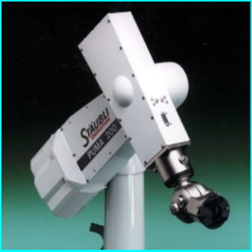
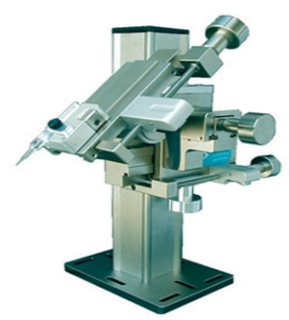
Types of Robots
1) Manipulators

Slide 9
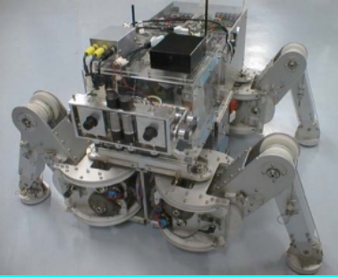
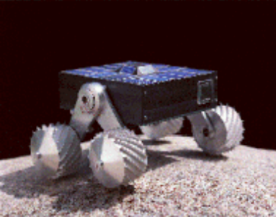
Types of Robots
2) Moving Robots (Legged or Wheeled).

Slide 10
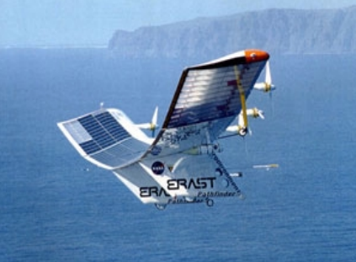
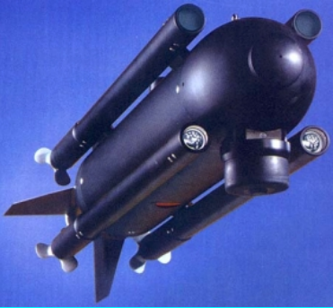
Types of Robots
3) Underwater and Arial Robots

Slide 11
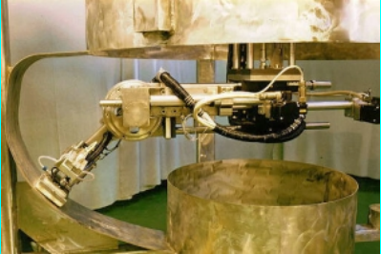
Y-Robots
For jobs that are dangerous for humans
Decontaminating Robot
Cleaning the main circulating pump housing in the nuclear power plant

Slide 12
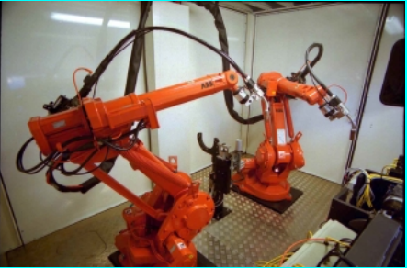
Y-Robots
Repetitive jobs that are boring, stressful, or labor-intensive for humans
Welding Robot

Slide 13
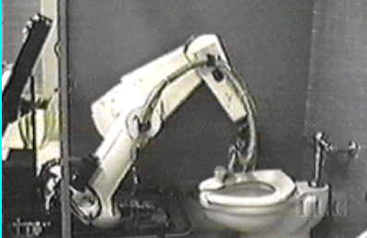
Y-Robots
Menial tasks that human don’t want to do ^-^
The SCRUBMATE Robot

Slide 14
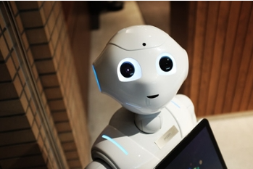
Robots, a lot older than you might think
Automaton vs Robot
Much like the history of cellphones, declaring anything as the first product of a technological trend depends entirely on your definition of that trend. For robots, these early ancestors that aren’t technically robots are known as automatons.
At its most basic, the difference here is that an automaton carries out predetermined actions based on specific instructions.
Automatons can only perform a limited number of functions based on very precise inputs.
Robots can operate on their own and are programmable, which gives them a level of versatility.

Slide 15

Automatons
The first recorded designs for an automaton date back to 1206, Drafted and developed by polymath Al-Jazari.
the floating orchestra featured a four-person ensemble.
It is a mechanical band made up of two drummers, a flautist and a harp player.
The mechanical band sits atop a rotating drum with pegs connected to levers that generate different musical sounds.
The interesting part is that the pegs could be replaced so that the band could play another song.
Although this machine looks nothing like a modern robot, its ability to be programmed to play different songs deserves recognition.
This is a design of the floating musical band that Al-Jazari created

Slide 16
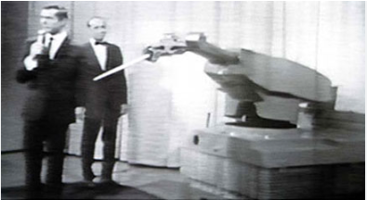
Robots
Determining the “first” of any technology is clearly a difficult proposition. However, it’s impossible to deny that Unimate was the first modern industrial robot.
The inventor George Devol filed a design patent for the robot in 1954, but it wasn’t until 1959 that the prototype was built.
The device's purpose was to lift hot pieces of metal from die casting machines and transport them to a different spot.
Johnny Carson welcoming the Unimate on the Tonight Show, 1966.

Slide 17
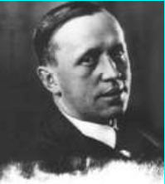
Robots in Art and Literature!
The word robot was coined by a Czech novelist Karel Capek in a 1920 play titled Rassum’s Universal Robots (RUR)
Robot in Czech is a word for worker or servant
Leonardo Da Vinci drew sketches for a mechanical knight that would theoretically be able to move its head, cross its arms, and perform other human functions.
Karel Capek

Slide 18
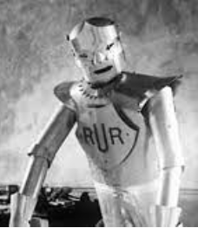
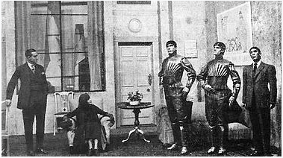
Robots in Art and Literature!
The R.U.R Robot
A scene from the play, showing three robots

Slide 19
Meet Enzo, Our Multi-Tasking Robot
The creation of ‘Enzo’ is for pure educational purposes.
If want to teach your students or your children how to program, how to deal with technology without them being paniced, we see that ‘Enzo’ is an interesting, amusing and practical way to give your little buds a sunlight, and watch them grow!!

Slide 20
—’George Krasadakis’ Author of theinnovationmode.com and 60leaders.com
“Novelty is essential for innovation, but it is not the definitive factor for its success”.

Slide 21
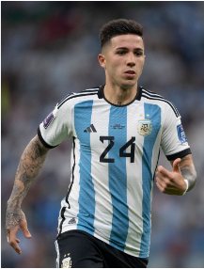
Novelty of the name
Choosing the name ‘Enzo’ was not a random choice, we wanted name that gives a nice first impression, and describes the character of the robot, small, multi-tasking and some-how fast, and by searching (and watching the world cup tournament matches), we found that the football Argentinian midfielder ‘Enzo Fernandez’ has what we need, so we named the robot after him.
Enzo Fernandez, an Argentinian football player

Slide 22
Working Principles
02
What is “Enzo the robot” built for!

Slide 23
Self-Balancing
The aim of a self-balancing is to balance itself on two wheels, being able to drive around without toppling over.
Self-balancing robots use a “closed-loop feedback control” system
This means that real-time data from motion sensors is used to control the motors and quickly compensate for any tilting motion in order to keep the robot upright
Proportional-integral-derivative (PID) controllers are used to control the motion and position.
Self balance is achieved by the usage of a gyroscope with the help of the motor driver.

Slide 24
Obstacle Detection
The robot gets the information from the surrounding area through mounted sensors on the robot.
Whenever the robot is going on the desired path the ultrasonic sensor transmits the ultrasonic waves continuously from its sensor head.
Whenever an obstacle comes ahead of it the ultrasonic waves are reflected from an object and that information is passed to the microcontroller.
The microcontroller controls the motors left, right, back, front, based on ultrasonic signals. To control the speed of each motor pulse width modulation is used (PWM).

Slide 25
Path (Line) Following
The concept of the line follower robot is related to light.
It’s following a visual line embedded on the surface. This visual line is a path on which the line follower robot runs.
Generally, it uses a black line on a white surface (you can adjust it as a white line on a black surface).
Usually, beginners and students would get their first robotic experience with this type of robot (and that’s what Enzo is all about, teaching beginners how to automate).

Slide 26
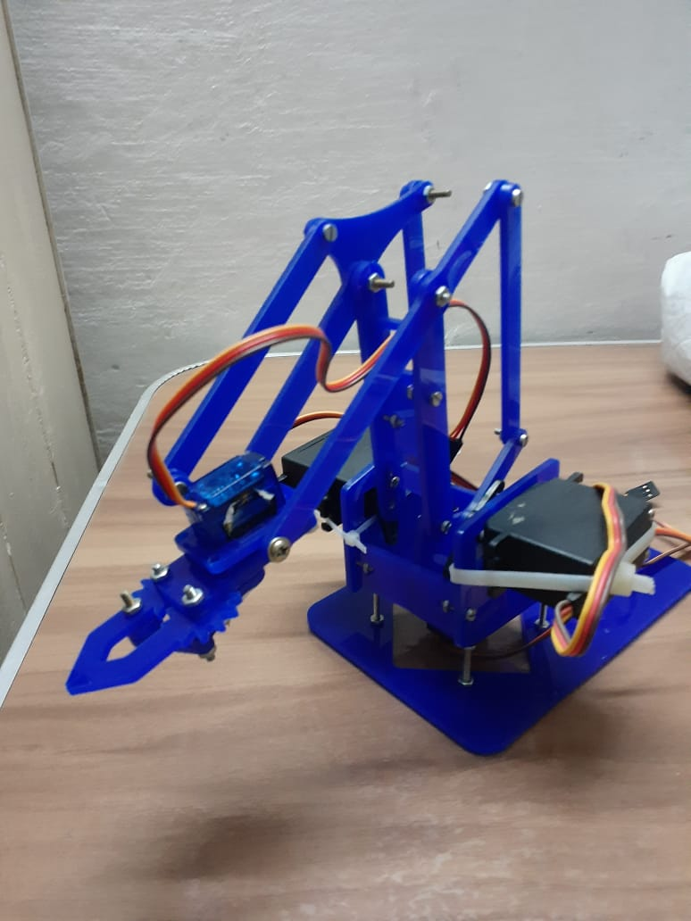
Robot-Arm
The arm is based on 4 servo motors (one for the base, one for the gripper and 2 for lifting the arm vertically). To control the arm we use 4 potentiometers (one for each servo).
Our controller is arduino uno we use 4 analog pins for potentiometers readings and 4 pwm pins to control servo motors.
Input signal is an analog signal we get from potentiometer and map it in range of (0,180) and use it to control servo motor as a control signal

Slide 27
03
Components
How we got Enzo into life!!

Slide 28
Components Used
1xESP-WROOM-32 board
Body
1xMPU-6050 (Accelerometer + Gyroscope)
1xHC-SR04 (Ultra-Sonic Sensor)
2xDC Geared Motor with wheels
1xSwitch
4xServo Motors
1xIR Sensor Module 4-Channels
1xL298 Motor Driver
4xPotentiometers
1x Battery Charger

Slide 29

04
Y-Section
Why we used these specific components

Slide 30
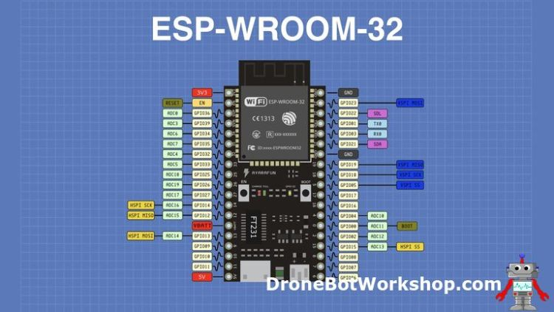
ESP-WROOM-32
Dual Core,32-Bit Microcontroller.
Clock frequency up to 240 MHz.
Integrated WIFI, Bluetooth and BLE.
Up to eighteen 12-bit ADC converters.
Two I2C bus connections.
Four SPI bus channels.
Three UARTs.
Can supply PWM for motor control.
Real Time Clocks.

Slide 31
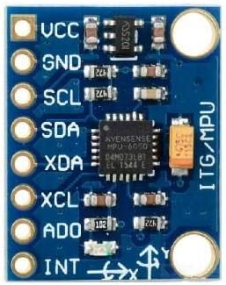
MPU-6050 IMU
Consists of an accelerometer and a gyroscope
IMU = “Inertial Measurement Unit”
The IMU has 6-degree of freedom (3 axis from accelerometer and 3 from gyroscope).
Degree of Freedom(DOF): Ability to move in 3 different directions (length, width and height).
MPU-6050 is a MEMS (Micro Electro Mechanical System).

Slide 32
MPU-6050 IMU Cont.
MPU-6050 has a temperature sensor.
MPU-6050 has a DMP (Digital Motion Processor)
Correlate data from accelerometer and gyroscope
Uses external 3rd party sensors which connect using 2nd I2C Communication Protocol

Slide 33
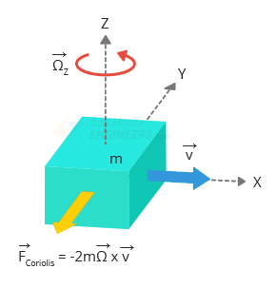
Gyroscope
Measure rotational motion (angular velocity) on three different axis (X-Y-Z).
The outputs of the gyroscope are in degrees per second, so in order to get the angular position we just need to integrate the angular velocity.
MPU-6050 is a MEMS Gyroscope (Micro Electro Mechanical System).
MEMS sensors produce voltage when axis is rotated, sampled with by 16-bit ADC.

Slide 34
Gyroscope Cont.
While accelerometers measure linear acceleration, gyroscopes measure angular rotation. To accomplish this, they measure the force generated by the Coriolis Effect.
Coriolis Effect: The Coriolis Effect states that when a mass (m) moves in a specific direction with a velocity (v) and an external angular rate (Ω) is applied (Red arrow), the Coriolis Effect generates a force (Yellow arrow) that causes the mass to move perpendicularly.
The value of this displacement is directly related to the angular rate applied.

Slide 35
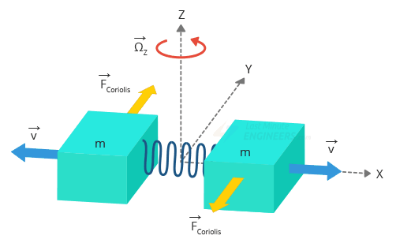
Gyroscope Cont.
Consider two masses oscillating in opposite directions at a constant frequency.
When an angular rate is applied, the Coriolis effect produced by each mass is in opposite directions, resulting in a proportional change in capacitance between the masses.
By measuring this change in capacitance, the angular rate can be calculated.

Slide 36
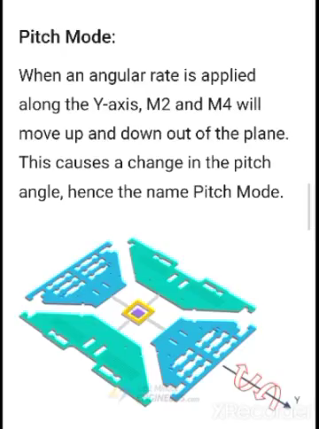
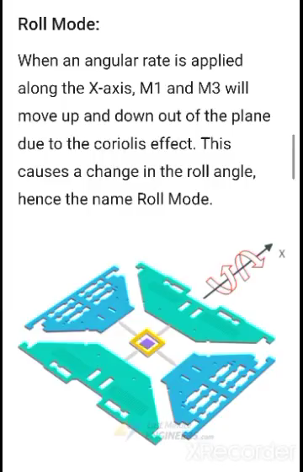
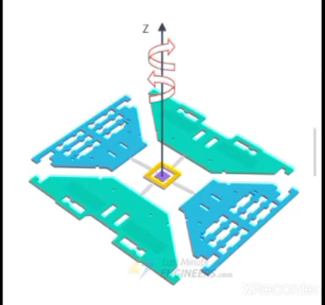
Modes of Gyroscope

Slide 37

Gyroscope Disadvantages
They are good for short-term and quick movements, but tend to drift over time as the error accumulates.
They also record a lot of jitter and noise, which needs to be filtered by the micro-controller before the data can be used.
To reduce this drifting effect of the gyroscope, it is possible to combine the sensor data with that from an accelerometer.
The accelerometer is good at sensing slower and more prolonged movements, rather than the fast motion.
Therefore if we take the best of both worlds and fuse the data together, we will be left with an extremely accurate picture of the motion of the robot.
As a result we decided to use a combined accelerometer & gyroscope breakout module (the MPU-6050), which is slightly more expensive than a simple gyro, but should lead to a superior stabilization performance.

Slide 38
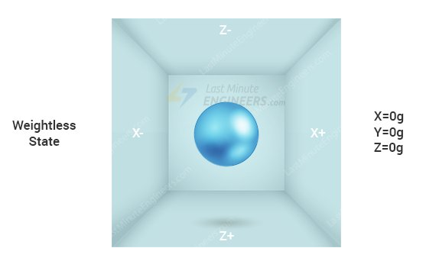
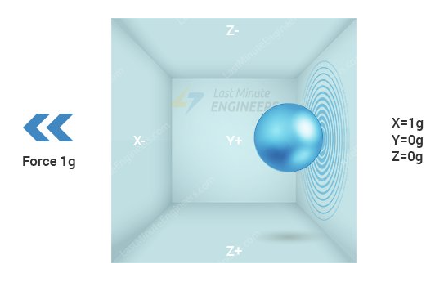
Accelerometer
To understand how accelerometers work, imagine a ball inside a 3D cube.
Case1: Assuming that the cube is in outer space, where everything is weightless!
The ball will simply float in the center of the cube.
Assume that each wall represents a specific axis.
If we suddenly move the box to the left with acceleration 1g (a single G-force 1g is equivalent to gravitational acceleration 9.8 m/s2), the ball will undoubtedly hit the wall X.
If we measure the force the ball exerts on wall X, we can obtain an output value of 1g along the X axis.

Slide 39
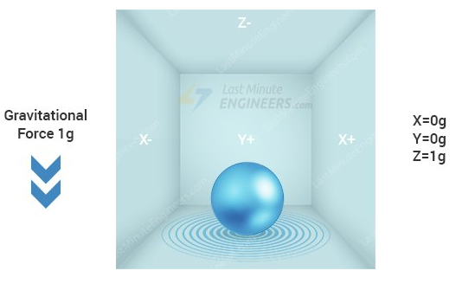
Accelerometer Cont.
Case2: when we place that cube on Earth.
The ball will simply fall on the wall Z, exerting a force of 1g.
n this case, the box isn’t moving, but we still get a 1g reading on the Z axis!!!.
This is because gravity is pulling the ball downward with a force of 1g.

Slide 40
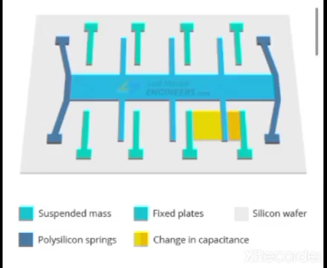
MEMS Accelerometer
This structure is suspended by polysilicon springs. It allows the structure to deflect when accelerated along the X, Y, and/or Z axes.
As a result of deflection, the capacitance between fixed plates and plates attached to the suspended structure changes. This change in capacitance is proportional to the acceleration along that axis.
The sensor processes this change in capacitance and converts it into an analog output voltage.

Slide 41
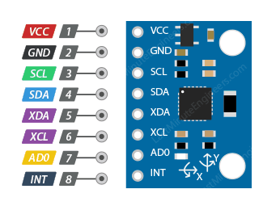
MPU6050 Pinout
VCC supplies power to the module.
GND is the ground pin.
SCL is a serial clock pin for the I2C interface.
SDA is a serial data pin for the I2C interface.
XDA is the external I2C data line. The external I2C bus is for connecting external sensors, such as a magnetometer.
XCL is the external I2C clock line.
AD0 allows you to change the I2C address of the MPU6050 module, the default I2C address is 0x68HEX; when you connect it to 3.3V, the line is pulled HIGH, and the I2C address becomes 0x69HEX.
INT is the Interrupt Output pin, The MPU6050 can be programmed to generate an interrupt upon detection of gestures, panning, zooming, scrolling, tap detection, and shake detection.

Slide 42
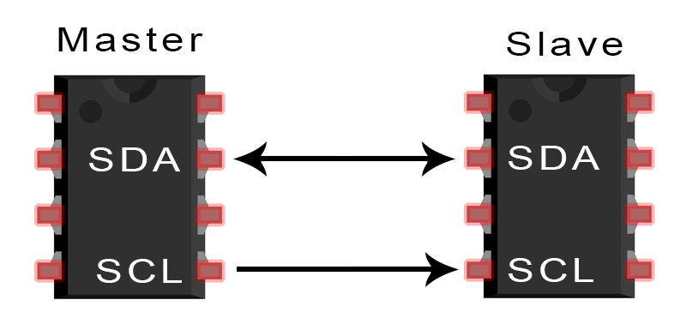
I2C Communication Protocol
I2C stands for the Inter-Integrated Controller.
It is a master-slave communication in which we can connect and control multiple slaves from a single master. In this, each slave device has a specific address.
This is a serial communication protocol that can connect low-speed devices.
This protocol requires only two cables:
SDA (Serial Data) – The line for the master and slave to send and receive data.
SCL (Serial Clock) – The line that carries the clock signal.

Slide 43
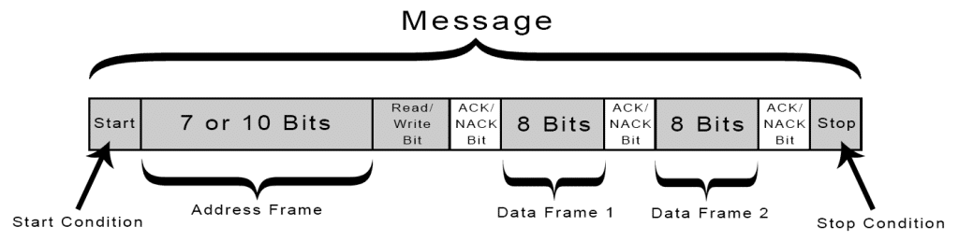
HOW I2C WORKS
With I2C, data is transferred in messages, messages are broken up into frames of data.
Each message has an address frame that contains the binary address of the slave, and one or more data frames that contain the data being transmitted.
The message also includes start and stop conditions, read/write bits, and ACK/NACK bits between each data frame:

Slide 44
HOW I2C WORKS
Start Condition: The SDA line switches from a high voltage level to a low voltage level before the SCL line switches from high to low.
Stop Condition: The SDA line switches from a low voltage level to a high voltage level after the SCL line switches from low to high.
Address Frame: A 7 or 10 bit sequence unique to each slave that identifies the slave when the master wants to talk to it.
Read/Write Bit: A single bit specifying whether the master is sending data to the slave (low voltage level) or requesting data from it (high voltage level).
ACK/NACK Bit: Each frame in a message is followed by an acknowledge/no-acknowledge bit. If an address frame or data frame was successfully received, an ACK bit is returned to the sender from the receiving device.

Slide 45
STEPS OF I2C DATA TRANSMISSION
The master sends the start condition to every connected slave by switching the SDA line from a high voltage level to a low voltage level before switching the SCL line from high to low.
The master sends each slave the 7 or 10 bit address of the slave it wants to communicate with, along with the read/write bit.
Each slave compares the address sent from the master to its own address. If the address matches, the slave returns an ACK bit by pulling the SDA line low for one bit. If the address from the master does not match the slave’s own address, the slave leaves the SDA line high.
The master sends or receives the data frame.
After each data frame has been transferred, the receiving device returns another ACK bit to the sender to acknowledge successful receipt of the frame.
To stop the data transmission, the master sends a stop condition to the slave by switching SCL high before switching SDA high.

Slide 46
I2C Advantages
This protocol requires only two cables (like UART).
Hardware is less complicated than with UARTs.
Well known and widely used protocol.
Each device on the bus is controlled separately.
The devices can work as both master and slave (like SPI).
It supports long-distance communication than SPI.
ACK/NACK bit gives confirmation that each frame is transferred successfully

Slide 47
I2C Disadvantages
The complexity of hardware raises when the number of master/slave devices are high in the circuit.
It supports a half-duplex mode for communication, that adds complexity.
The size of the data frame is limited to 8 bits.
Slower data transfer rate than SPI.

Slide 48
PID Control
PID, or Proportional-Integral-Derivative, is a type of control system used to regulate the behavior of a system.
It is used in a variety of applications, such as robotics, automotive systems, and industrial control systems.
The PID system works by taking in a measured value, such as the position of a robot arm, and comparing it to a desired value.
It then calculates the difference between the two values and uses this difference to adjust the system accordingly.
The proportional, integral, and derivative components of the PID system are used to adjust the system in a way that will bring the measured value closer to the desired value.
This type of control system is used in many applications because it is reliable, efficient, and easy to implement.

Slide 49
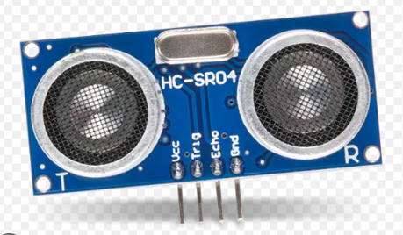
HC-SR04 USDS
Used for the object-avoidance task.
Ultrasonic distance sensors use pulses of ultrasonic sound to detect the distance between them and nearby solid objects.
The sensors consist of two main components:
An Ultrasonic Transmitter – This transmits the ultrasonic sound pulses, it operates at 40 KHz
An Ultrasonic Receiver – The receiver listens for the transmitted pulses. If it receives them it produces an output pulse whose width can be used to determine the distance the pulse travelled.

Slide 50
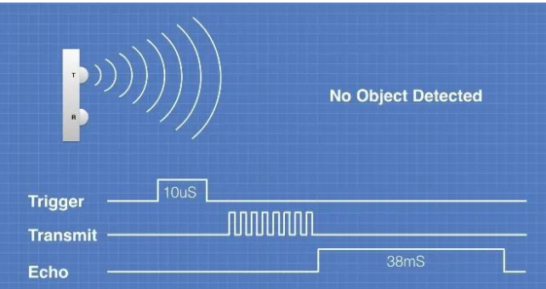
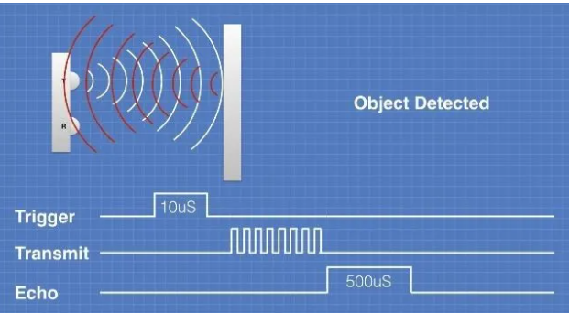
HC-SR04 USDS Operation
Trigger Pin is sent a 5 or 3.3V 10us pulse
The USS responds by transmitting a burst of eight pulses at 40 KHz.
Echo pin outputs a pulse of [150us,250ms], depending upon the time it took for the signal to be received..
The pulse width of the ECHO pulse is used to calculate the distance.
If no object is detected, pulse times out after 38ms.

Slide 51
HC-SR04 USDS Pinout
Trigger Pin is sent a 5 or 3.3V 10us pulse
The USS responds by transmitting a burst of eight pulses at 40 KHz.
Echo pin outputs a pulse of [150us,250ms], depending upon the time it took for the signal to be received..
The pulse width of the ECHO pulse is used to calculate the distance.
If no object is detected, pulse times out after 38ms.

Slide 52
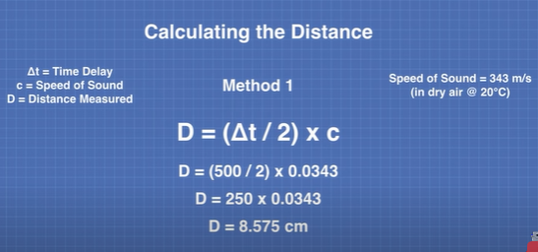
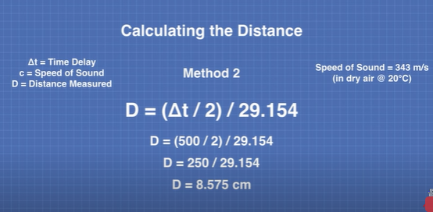
Distance Calculation Using Echo Pulse Width

Slide 53
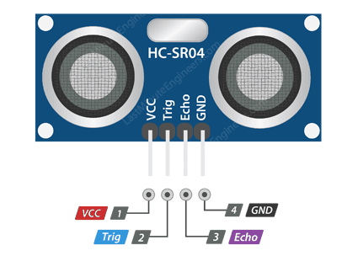
HC-SR04 Pinout
VCC supplies power to the HC-SR04 ultrasonic sensor.
Trig (Trigger) pin is used to trigger ultrasonic sound pulses. By setting this pin to HIGH for 10µs, the sensor initiates an ultrasonic burst.
Echo pin goes high when the ultrasonic burst is transmitted, and remains high until the sensor receives an echo, after which it goes low. By measuring the time the Echo pin stays high, the distance can be calculated.
GND is the ground pin.

Slide 54
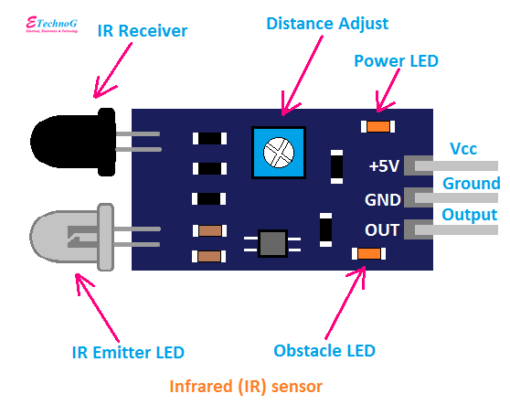
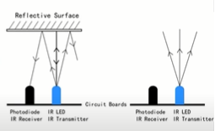
IR Active Sensor
Used for the line follower task.
the inferred sensor works on the principle of measuring and detecting the inferred radiation surrounding or focused on it.
The circuit is built with both a photodetector and a light emitter.
IR Active Sensor Operation:
The light emitter or LED continuously remains on when the circuit is connected to a DC supply
The light generated by the emitter hits that object and falls upon the light detector reflected by the object.
So, the sensor gives the output signal.

Slide 55
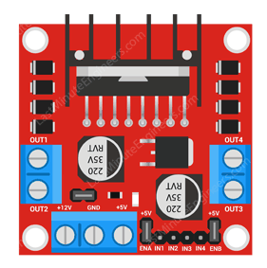
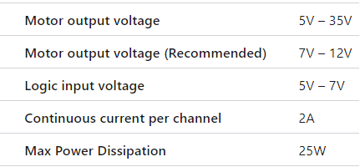
L298N Motor Drive
A BJT-transistor based motor drive
Used for controlling the wheels motors.
Specifications

Slide 56
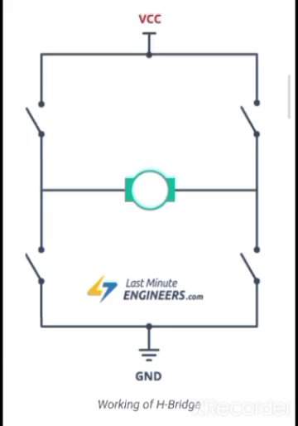
L298N Motor Drive Operation
The spinning direction of a DC motor can be controlled by changing the polarity of its input voltage.
A widely used technique to accomplish this is to use an H-bridge.
An H-bridge circuit is made up of four switches arranged in a H shape, with the motor in the center.
Closing two specific switches at the same time reverses the polarity of the voltage applied to the motor.
This causes a change in the spinning direction of the motor.

Slide 57
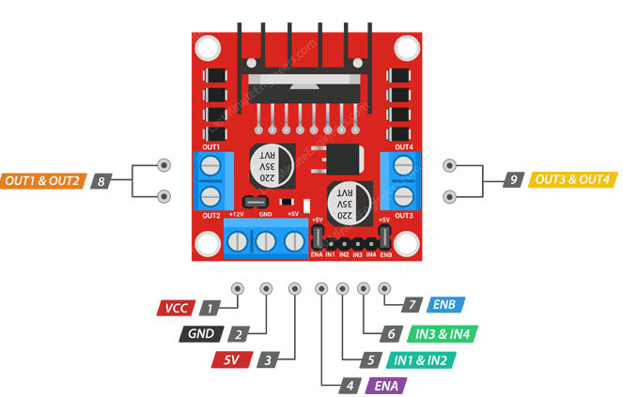
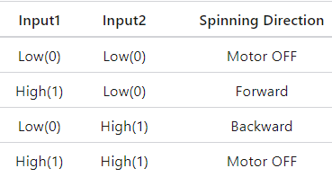
L298N Pinout
Power Pins
Vs pin: powers the IC’s internal H-Bridge, which drives the motors. This pin accepts input voltages ranging from 5 to 12V.
Vss: is used to power the logic circuitry within the L298N IC, and can range between 5V and 7V.
GND: is the common ground pin.
2. Output Pins
OUT1 and OUT2 for motor A
OUT3 and OUT4 for motor B
3. Direction Control Pins
IN1 and IN2 pins control the spinning direction of motor A
IN3 and IN4 control the spinning direction of motor B
4. Speed Control Pins
The speed control pins ENA and ENB are used to turn on/off the motors and control their speed.
With Pulse Width Modulation (PWM), the speed of the motors
can be controlled.

Slide 58
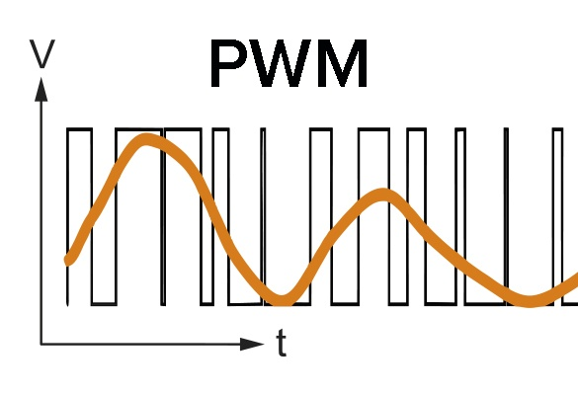
Pulse Width Modulation (PWM)
Pulse Width Modulation, or PWM, is a technique for getting analog results with digital means.
It is an effective method that is used to control the amount of power delivered to a load without dissipating any wasted power.
In the PWM technique, the signal’s energy is distributed through a series of pulses rather than a continuously varying (analogue) signal.
PWM reduces the average power delivered by an electrical signal by converting the signal into discrete parts.

Slide 59
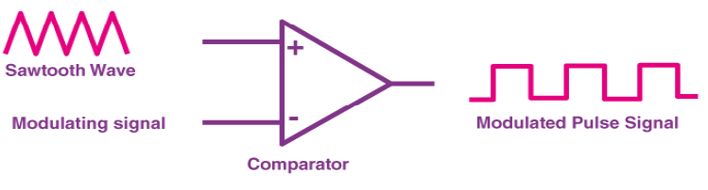
How is a Pulse Width Modulation Signal generated?
A pulse width modulating signal is generated using a comparator .
The comparator compares two signals and generates a PWM signal as its output waveform.
The modulating signal forms one part of the input to the comparator, while the non-sinusoidal wave or sawtooth wave forms the other part of the input.
If the sawtooth signal is more than the modulating signal, then the output signal is in a “High” state.
The value of the magnitude determines the comparator output which defines the width of the pulse generated at the output

Slide 60
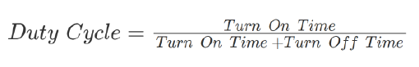
Duty Cycle of PWM
Duty Cycle: The percentage of time for which the signal remains “ON”.
As we know, a PWM signal stays “ON” for a given time and stays “OFF” for a certain time.
The average value of the voltage depends on the duty cycle. As a result, the average value can be varied by controlling the width of the “ON” of a pulse.

Slide 61
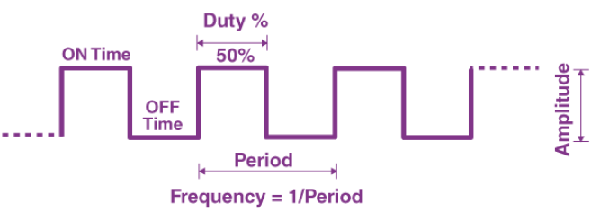
The Frequency of PWM
The frequency of PWM determines how fast a PWM completes a period.
The frequency of PWM can be calculated as follows:
Frequency = 1/Time Period
Where, Time Period = On Time + OFF time.
Output Voltage of PWM signal: The output voltage of the PWM signal will be the percentage of the duty cycle.
For example, for a 100% duty cycle, if the operating voltage is 5 V then the output voltage will also be 5 V. If the duty cycle is 50%, then the output voltage will be 2.5 V

Slide 62
What is the difference between the duty cycle and the frequency of a PWM signal?
POC | Duty cycle of PWM | Frequency of PWM
Description | Describes how often the signal switches between high and low voltages. | It is the percentage of time the signal stays at a high voltage.
Unit | Hertz | %

Slide 63
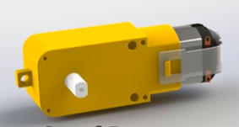
TT DC-Geared Motor
Main Specifications
Easy, low-cost way to get your projects moving.
Gear ratio of 1:48.
Operating Voltage: 3~6V.
No-Load Current: 190mA (Max 250mA).
Operating Speed (4.5V): 90+/- 10% RPM.
Max Operating Speed (6V): 250 RPM at no load.
Max torque : 800 gf.cm (3V).

Slide 64
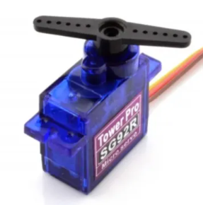
Micro Servo Motor SG92R
Parameters-Voltage 4,8 V:
Speed: 0.1 sec/60°
Torque: 2,5 kg*cm (0.24 Nm).
Consumption 0.5 A (max 0.7 A).
SERVO – RANGE: 180°.
Operating temperature: 0 – 55 °C.
SERVO – RANGE: Analog.
The servo motor has 3 pins (Vcc, Gnd and control) the control signal that comes from arduino is pwm based on the angle that provided by the potentiometer.

Slide 65
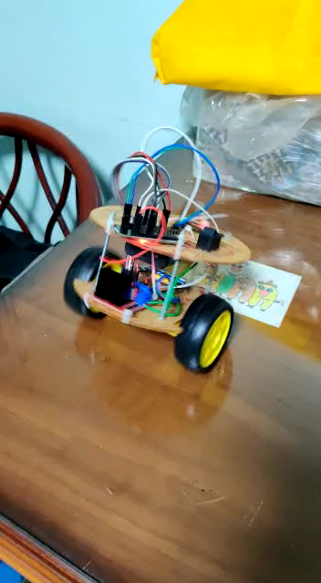
Enzo DEMO
“Enzo” celebrating Argantina’s winning the World Cup.

Slide 66

Enzo DEMO
“Enzo’s” baby steps

Slide 67

REVIEWS on Enzo
“Think ‘Enzo’ will be great for my students to learn, how much do you want for it!!!!”
Rimon Tharwat
- A robotics instructor for kids, treasure academy
“The robot is small in size but great in functionality, I really loved it, I wish learn automation embedded systems to build some of those”.
Abanoub Samir (Bob)
-A fresh graduate mechanical engineer, and embedded systems enthusiast

Slide 68

Cost Analysis
06
How much did we spent on the project
Or
How much did the electronics shops gained from us ^-^.

Slide 69
Your Project should be Fast, Cheap or Good Pick Two. ‘A Wise Saying’

Slide 70
Cost Analysis
Component | Number | Price for One | Already Have One | Total Paid
ESP-WROOM-32 board | 1 | 140 | Yes | 0
Body | 1 | 100 | No | 100
MPU-6050 | 1 | 90 | No | 90
IR Sensor Module 4-Channels | 1 | 90 | No | 90
HC-SR04 | 1 | 40 | No | 40
L298N | 1 | 60 | No | 60
DC Geared Motor | 2 | 30 | No | 60

Slide 71
Cost Analysis Cont.
Component | Number | Price for One | Already Have One | Total Paid
Wheels | 2 | 20 | No | 40
Vero Board | 1 | 10 | No | 10
Batteries | 2 | 25 | No | 50
Holder for USS | 1 | 10 | No | 10
Arm | 1 | 100 | No | 100
Servo Motors | 4 | 50 | 2 out of 4 | 100
Potentiometers | 4 | 5 | Yes | 0
Other |  |  |  | 250

Slide 72


1000 EGP
The total cost of the robot.

Slide 73

Cost Pie-Chart
26%
10%
Robot Arm
Motors and Drivers
The arm considers a good bonus for us,so it worth a fair cost
Robot is all about motion, so this is a reasonable persentage
22%
25%
Sensors
Others
Stuff like coffee shops, workspaces and food are not cheap at all these days.
Robot systems are closed loop, so sensors are essential for the system

Slide 74
Costs Per Task
535E
485E
375E
TOT
525E
1920E
Self Balance
Robot Arm
Line Follower
Total
Object
Avoidance

Slide 75
Conclusion
920 L.E.
48%
Difference in cost between both cases
(making one robots for all tasks, and making one robot for each task).
Percentage save.

Slide 76

We can conclude that our robot is highly cost-saving

Slide 77
COMPETITOR ANALYSIS
COMPETITORS
Vortex
MIA Team
Croco Marine
Electronics company and educational center, famous for their projects and participation in global competitions
Well-known team in faculty of engineering, Alexandria, famous for their projects and participation in global competitions
Well-known team in faculty of engineering, Alexandria, famous for their projects and participation in global competitions in ROVs

Slide 78
TARGET
Expected
Target Range
1
2
3
Easy to Implement
70%
Practical
50%
Easy to Implement
Practical
Economical
Economical
60%
Fact
The robot needs basic knowledge about hardware, sensors and coding with C and Arduino
Our robot aims to advance robotic education, It instructs young kids in the fundamentals of robotics would be our potential clients.
About 1000 LE is spent on our robot. Other companies' robots are found to cost more than 6000, , which is far more than the price we are offering.

Slide 79

PREDICTED GROWTH
Up to 81%
2022 -2025
There are numerous huge corporations, like LEGO and VEX, in this very crowded and competitive sector, Our robot is expected to dominate the market because our price is so much lower than that of other firms who offer higher capabilities.

Slide 80

Timeline
08
How long did the process take?

Slide 81
Process Phases
Idea | Hardware | Software | Testing and modifications | Show Time
Brainstorming to get an idea that is: 1- New 2- Affordable 3-Applicable | Robot Assembly | 1-Studying codes on the internet 2-Coding in ESP32 | Testing behavior of the robot and modify errors (software -hardware). | Presentation & Documentation

Slide 82
TIMING
PHASE 1
PHASE 2
PHASE 3
PHASE 4
PHASE 5
Idea
Hardware
Software
Testing
And modifications
Show Time
3-Days
3-Days
3-days
3-Days
10 Days
The process overall took around 3-weeks

Slide 83

Difficulties
09
When things start to get REALLY BAD

Slide 84
Difficulties Types
Hardware
Bad Circums
Software
Well, you never know where and when the sh*t comes from
Problems related to hardware design, implementation and material
Problems based on coding

Slide 85
Hardware Difficulties
The ESP-32 is always SOOO HOT! (N.B.: In electronics, that’s NOT a good thing).
Batteries are expensive and their chargers are even more expensive, so we had not to try for so long time, plus, PID values somewhat affected by the battery delivered power
Moving forward in the project, every thing was working well………Individually ^-^.

Slide 86
Software Difficulties
Programming ESP-32 is a bit difficult and unfamiliar compared to programming Arduino
PID values are basically defined by “Try and Error” method, so it cost us some time to get a proper results
Moving forward in the project, every thing was working well………Individually ^-^.

Slide 87
Other Difficulties
We had some difficulties with the availability of some material, for example, we spent a total of three days looking for some screws and nuts for the robot arm
We had to deal with (survive is more accurate) the other assignments of the course and of course, other courses of the term.
Moving forward in the project, we had to face the problem of always having a good internet.

Slide 88
RESOURCES
https://youtube.com/playlist?list=PLG314r7ePczd6uYaVthDqDeWcZQwgCdHw
https://youtube.com/playlist?list=PLG314r7ePczdfYFJSsPJFZL-P37Wyx-Cd
https://sciencenode.org/feature/A%20brief%20history%20of%20robots%20part%201.php
http://engineering.nyu.edu/mechatronics/smart/Archive/intro_to_rob/Intro2Robotics.pdf
https://wired.chillibasket.com/2014/10/accel-gyro-sensors/
https://lastminuteengineers.com/mpu6050-accel-gyro-arduino-tutorial/
https://lastminuteengineers.com/arduino-sr04-ultrasonic-sensor-tutorial/
https://www.seeedstudio.com/blog/2019/04/01/choosing-the-right-motor-for-your-project-dc-vs-stepper-vs-servo-motors/
http://kkfscs.weebly.com/pulse-width-modulation.html
https://wired.chillibasket.com/2014/09/balancing-robot-intro/
https://www.utmel.com/components/l293d-vs-l2978n-what-s-the-difference?id=1493#cat13
https://www.elprocus.com/obstacle-avoidance-robotic-vehicle/
https://dronebotworkshop.com/esp32-intro/
https://dronebotworkshop.com/hc-sr04-ultrasonic-distance-sensor-arduino/
https://dronebotworkshop.com/mpu-6050-level/
https://all3dp.com/2/esp32-vs-arduino-differences/
https://lastminuteengineers.com/l298n-dc-stepper-driver-arduino-tutorial/

Slide 89
RESOURCES
https://www.circuitbasics.com/basics-of-the-i2c-communication-protocol/
https://howtomechatronics.com/tutorials/arduino/arduino-and-mpu6050-accelerometer-and-gyroscope-tutorial/

Slide 90

Thank You

